Slide 1
BM25, BM25F, and User Behavior
Chris Manning and Pandu Nayak

Slide 2
Summary - BIM
Boils down to where
Simplifies to (with constant p_{i} = 0.5)
Log odds
ratio
 | document | relevant (R=1) | not relevant (R=0)
term present | x_{i} = 1 | p_{i} | r_{i}
term absent | x_{i} = 0 | (1 – p_{i}) | (1 – r_{i})
Notes:
Main point: Can start with PRP and end up with scoring function which is just simple sum of weights for query terms present in a document.

Slide 3
Graphical model for BIM
R
x_{i}
Binary
variables

Slide 4
A key limitation of the BIM
BIM – like much of original IR – was designed for titles or abstracts, and not for modern full text search
We want to pay attention to term frequency and document lengths, just like in other models we discuss
Want
Want some model of how often terms occur in docs

Slide 5
1. Okapi BM25
BM25 “Best Match 25” (they had a bunch of tries!)
Developed in the context of the Okapi system
Started to be increasingly adopted by other teams during the TREC competitions
It works well
Goal: be sensitive to these quantities while not adding too many parameters
(Robertson and Zaragoza 2009; Spärck Jones et al. 2000)

Slide 6

Generative model for documents
Words are drawn independently from the vocabulary using a multinomial distribution
... the draft is that each team is given a position in the draft …
basic
team
the
given
draft
each
nfl
annual
team
of
draft
nfl
football
design
is
that
football
…

Slide 7

Generative model for documents
Distribution of term frequencies (tf) follows a binomial distribution – approximates to a Poisson
... the draft is that each team is given a position in the draft …
draft
…
…

Slide 8
Poisson distribution
The Poisson distribution models the probability of k, the number of events occurring in a fixed interval of time/space, with known average rate λ (=cf/T), independent of the last event
Examples
Number of cars arriving at the toll booth per minute
Number of typos on a page

Slide 9
Poisson distribution
If T is large and p is small, we can approximate a binomial distribution with a Poisson where λ = Tp
Mean = Variance = λ = Tp.
Example p = 0.08, T = 20. Chance of 1 occurrence is:
Binomial
Poisson … already close

Slide 10
Poisson model
Assume that term frequencies in a document (tf_{i}) follow a Poisson distribution
“Fixed interval” implies fixed document length … think roughly constant-sized document abstracts
… will fix later

Slide 11
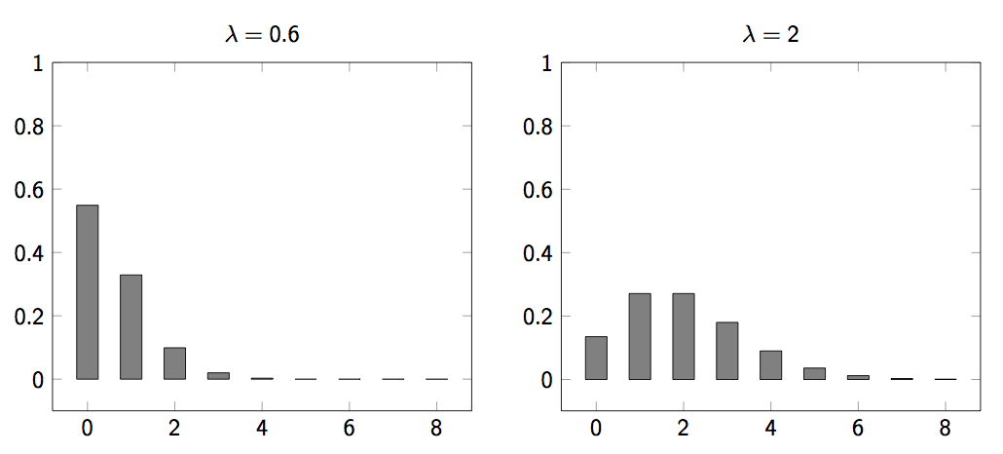
Poisson distributions

Slide 12
(One) Poisson Model
Is a reasonable fit for “general” words
Is a poor fit for topic-specific words
get higher p(k) than predicted too often
 |  | Documents containing k occurrences of word (λ = 53/650)
Freq | Word | 0 | 1 | 2 | 3 | 4 | 5 | 6 | 7 | 8 | 9 | 10 | 11 | 12
53 | expected | 599 | 49 | 2
52 | based | 600 | 48 | 2
53 | conditions | 604 | 39 | 7
55 | cathexis | 619 | 22 | 3 | 2 | 1 | 2 | 0 | 1
51 | comic | 642 | 3 | 0 | 1 | 0 | 0 | 0 | 0 | 0 | 0 | 1 | 1 | 2
Harter, “A Probabilistic Approach to Automatic Keyword Indexing”, JASIST, 1975

Slide 13
Eliteness (“aboutness”)
Model term frequencies using eliteness
What is eliteness?
Hidden variable for each document-term pair, denoted as E_{i} for term i
Represents aboutness: a term is elite in a document if, in some sense, the document is about the concept denoted by the term
Eliteness is binary
Term occurrences depend only on eliteness…
… but eliteness depends on relevance

Slide 14
Elite terms
Text from the Wikipedia page on the NFL draft showing elite terms
The National Football League Draft is an annual event in which the National Football League (NFL) teams select eligible college football players. It serves as the league’s most common source of player recruitment. The basic design of the draft is that each team is given a position in the draft order in reverse order relative to its record …

Slide 15
Graphical model with eliteness
R
E_{i}
Binary
variables
tf_{i}
Frequencies (not binary)
Notes:
Simple topic model … if you know other topic models like LDA, you might think of other ways of doing this. Here, the model directly boosts the term frequency of a bunch of words. Generative language model.

Slide 16
Retrieval Status Value
Similar to the BIM derivation, we have where and using eliteness, we have:

Slide 17
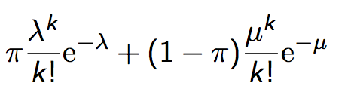
2-Poisson model
The problems with the 1-Poisson model suggests fitting two Poisson distributions
In the “2-Poisson”, the distribution is different depending on whether the term is elite or not
where π is probability that document is elite for term
but, unfortunately, we don’t know π, λ, μ

Slide 18
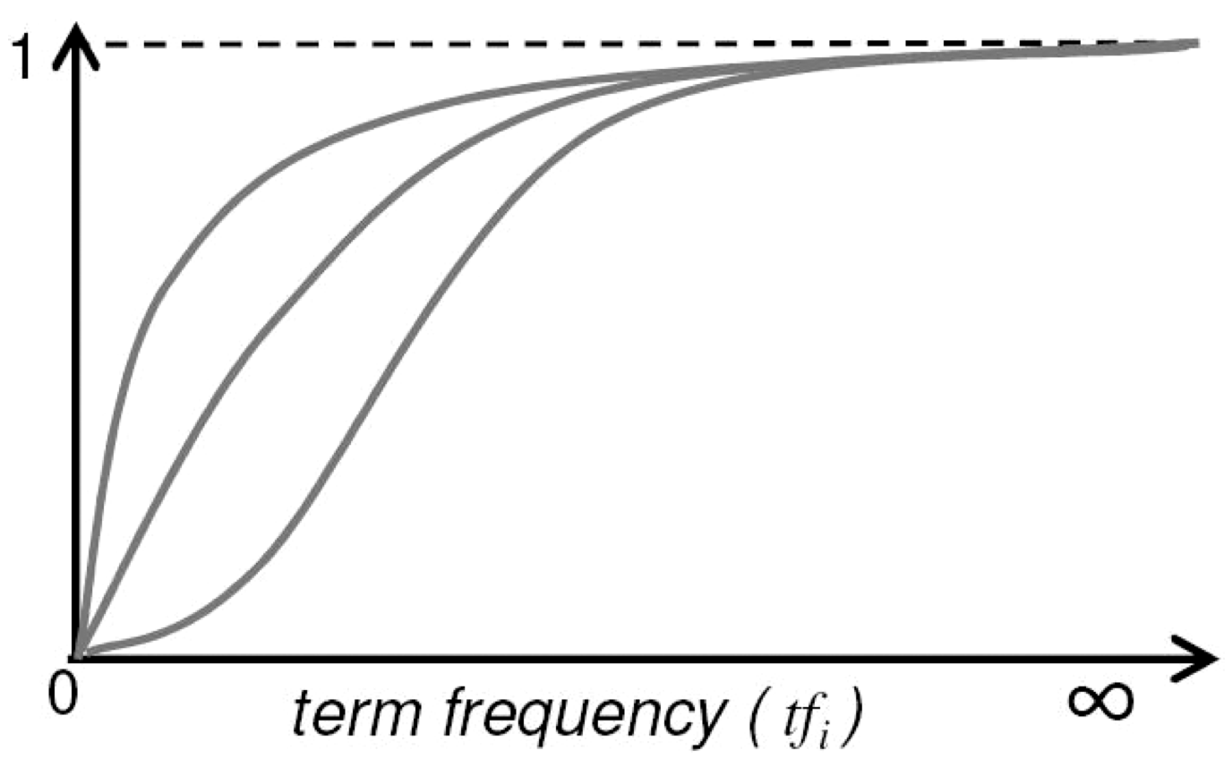
Let’s get an idea: Graphing for different parameter values of the 2-Poisson
Notes:
Concave upper two curves are for more “realistic” parameter values, so we want to approximate those ones not bottom ones.

Slide 19
Qualitative properties
increases monotonically with tf_{i}
… but asymptotically approaches a maximum value as [not true for simple scaling of tf]
… with the asymptotic limit being
Weight of eliteness feature

Slide 20
Approximating the saturation function
Estimating parameters for the 2-Poisson model is not easy
… So approximate it with a simple parametric curve that has the same qualitative properties

Slide 21
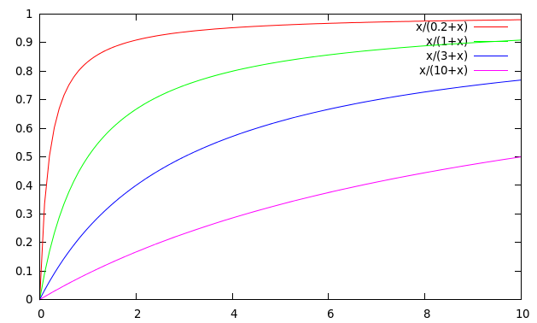
Saturation function
For high values of k₁, increments in tf_{i} continue to contribute significantly to the score
Contributions tail off quickly for low values of k₁

Slide 22
“Early” versions of BM25
Version 1: using the saturation function
Version 2: BIM simplification to IDF
(k₁+1) factor doesn’t change ranking, but makes term score 1 when tf_{i} = 1
Similar to tf-idf, but term scores are bounded
Notes:
But still don’t model document length

Slide 23
Document length normalization
Longer documents are likely to have larger tf_{i} values
Why might documents be longer?
Verbosity: suggests observed tf_{i} too high
Larger scope: suggests observed tf_{i} may be right
A real document collection probably has both effects
… so should apply some kind of normalization

Slide 24
Document length normalization
Document length:
avdl: Average document length over collection
Length normalization component
b = 1 full document length normalization
b = 0 no document length normalization

Slide 25
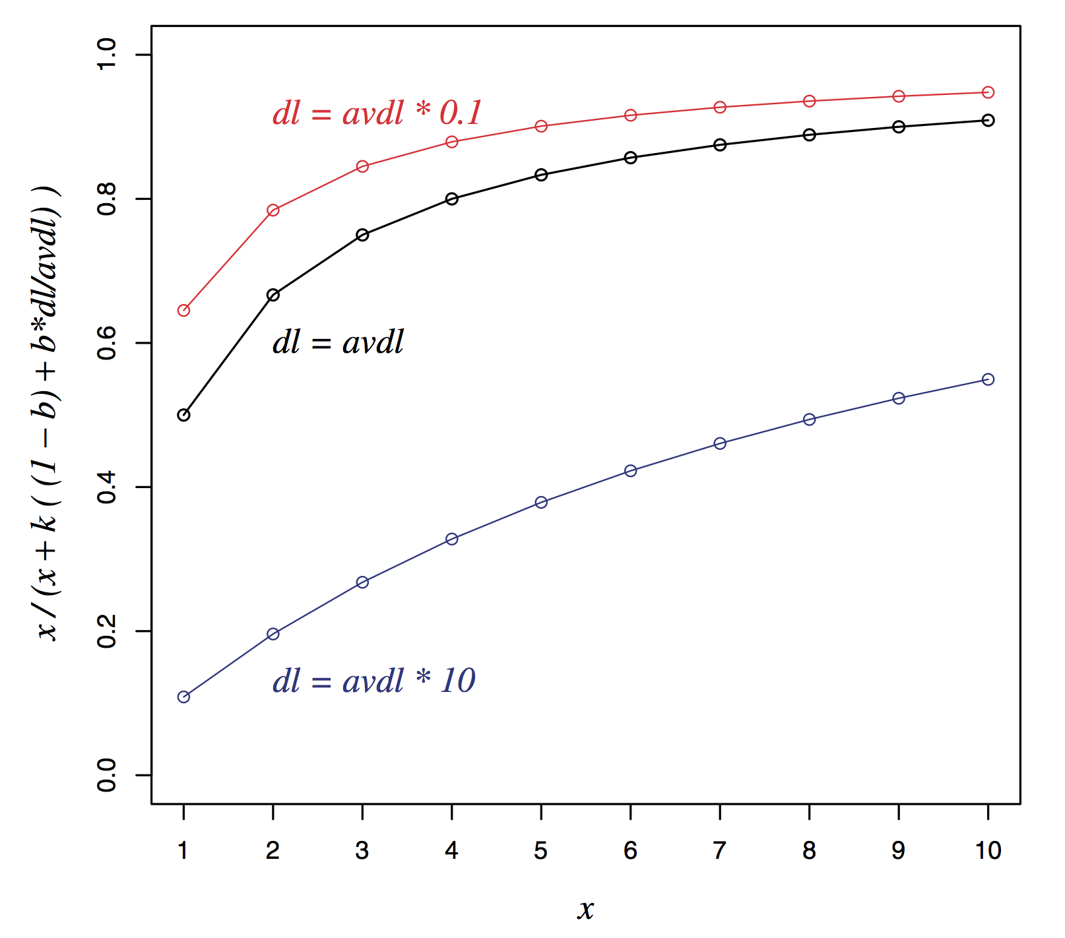
Document length normalization

Slide 26
Okapi BM25
Normalize tf using document length
BM25 ranking function

Slide 27
Okapi BM25
k₁ controls term frequency scaling
k₁ = 0 is binary model; k₁ = large is raw term frequency
b controls document length normalization
b = 0 is no length normalization; b = 1 is relative frequency (fully scale by document length)
Typically, k₁ is set around 1.2–2 and b around 0.75
IIR sec. 11.4.3 discusses incorporating query term weighting and (pseudo) relevance feedback

Slide 28
2. Ranking with features
Textual features
Zones: Title, author, abstract, body, anchors, …
Proximity
…
Non-textual features
File type
File age
Page rank
…

Slide 29
Ranking with zones
Straightforward idea:
Apply your favorite ranking function (BM25) to each zone separately
Combine zone scores using a weighted linear combination
But that seems to imply that the eliteness properties of different zones are different and independent of each other
…which seems unreasonable

Slide 30
Ranking with zones
Alternate idea
Assume eliteness is a term/document property shared across zones
… but the relationship between eliteness and term frequencies are zone-dependent
e.g., denser use of elite topic words in title
Consequence
First combine evidence across zones for each term
Then combine evidence across terms
Notes:
First is evidence for eliteness. Calculate saturation here.
Second is final document score

Slide 31
BM25F with zones
Calculate a weighted variant of total term frequency
… and a weighted variant of document length where
v_{z} is zone weight
tf_{zi} is term frequency in zone z
len_{z} is length of zone z
Z is the number of zones
Average
across all
documents

Slide 32
Simple BM25F with zones
Simple interpretation: zone z is “replicated” v_{z} times
But we may want zone-specific parameters (k₁, b, IDF)

Slide 33
BM25F
Empirically, zone-specific length normalization (i.e., zone-specific b) has been found to be useful
See Robertson and Zaragoza (2009: 364)

Slide 34
Ranking with non-textual features
Assumptions
Usual independence assumption
Independent of each other and of the textual features
Allows us to factor out in BIM-style derivation
Relevance information is query independent
Usually true for features like page rank, age, type, …
Allows us to keep all non-textual features in the BIM-style derivation where we drop non-query terms

Slide 35
Ranking with non-textual features
where
and is an artificially added free parameter to account for rescalings in the approximations
Care must be taken in selecting V_{j} depending on F_{j}. E.g.
Explains why works well

Slide 36

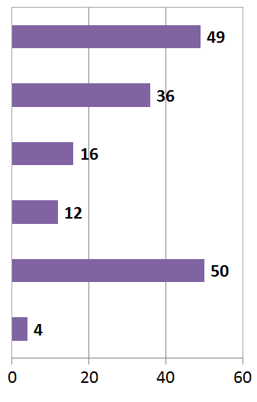
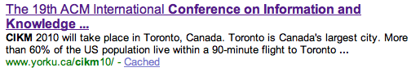
User Behavior
Taken with slight adaptation from Fan Guo and Chao Liu’s 2009 CIKM tutorial: Statistical Models for Web Search: Click Log Analysis
Search Results for “CIKM”
# of clicks received
Notes:
Does this show that our results are wrong?

Slide 37
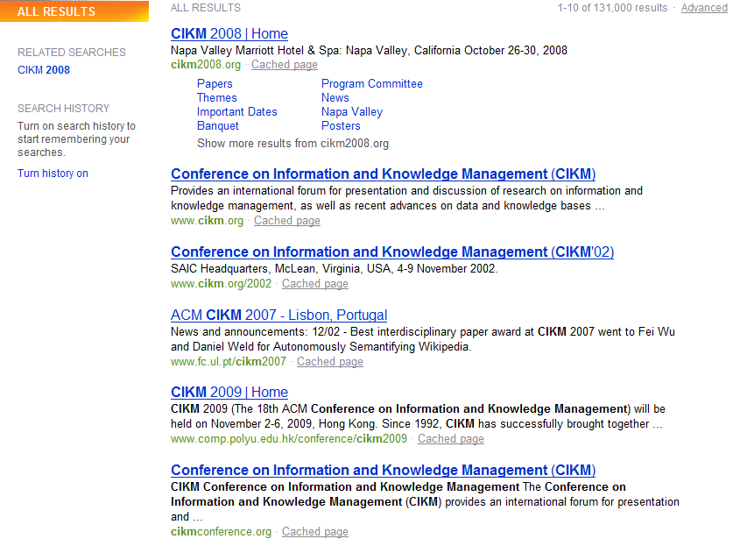
User Behavior
Adapt ranking to user clicks?
# of clicks received

Slide 38
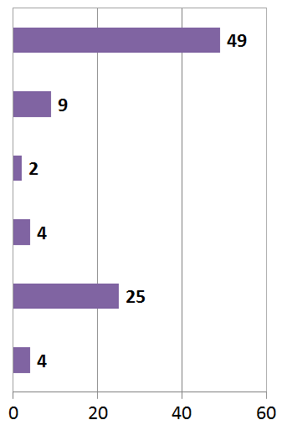

User Behavior
Tools needed for non-trivial cases
# of clicks received

Slide 39
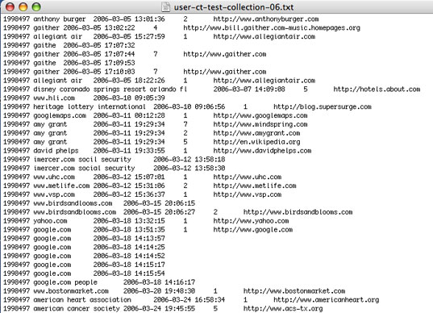
Web search click log
An example

Slide 40


Web Search Click Log
How large is the click log?
search logs: 10+ TB/day
In existing publications:
[Craswell+08]: 108k sessions
[Dupret+08] : 4.5M sessions (21 subsets * 216k sessions)
[Guo +09a] : 8.8M sessions from 110k unique queries
[Guo+09b]: 8.8M sessions from 110k unique queries
[Chapelle+09]: 58M sessions from 682k unique queries
[Liu+09a]: 0.26PB data from 103M unique queries

Slide 41
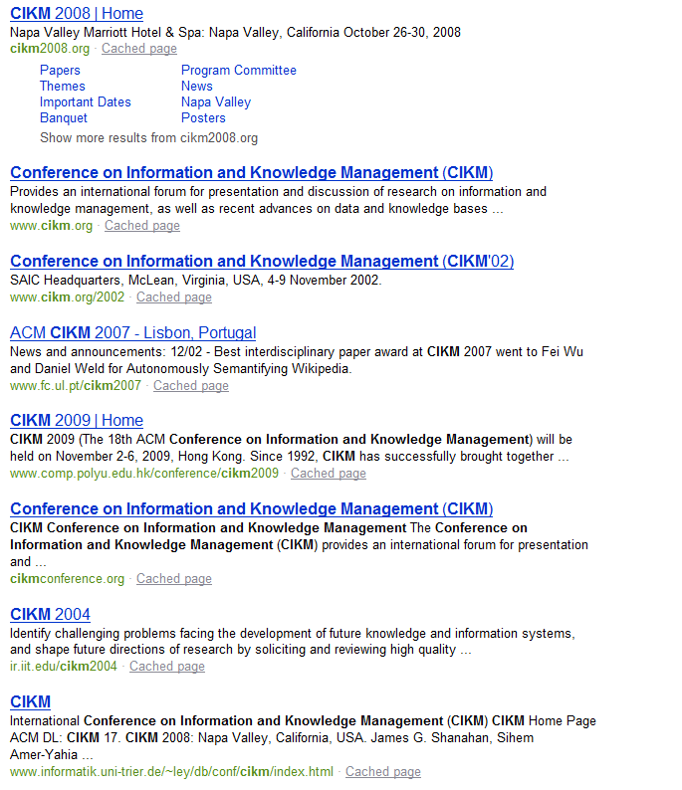


Interpret Clicks: an Example
Clicks are good…
Are these two clicks equally “good”?
Non-clicks may have excuses:
Not relevant
Not examined

Slide 42
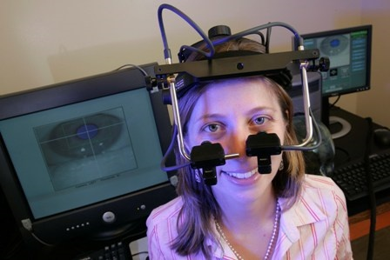
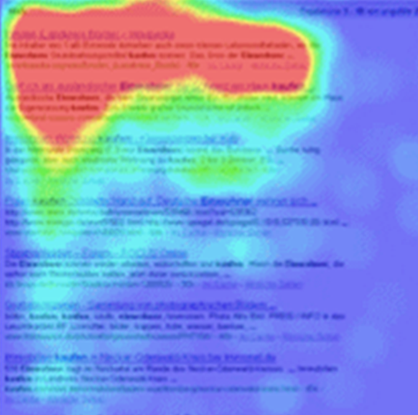

Eye-tracking User Study

Slide 43
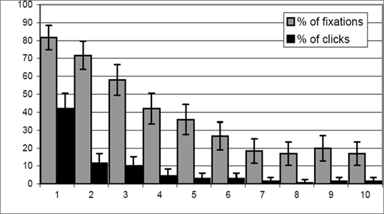
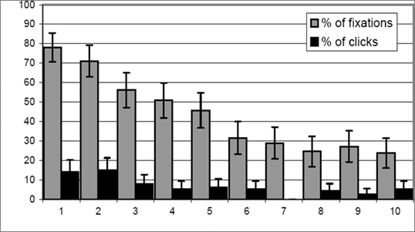
Click Position-bias
Higher positions receive more user attention (eye fixation) and clicks than lower positions.
This is true even in the extreme setting where the order of positions is reversed.
“Clicks are informative but biased”.
Percentage
Normal Position
Percentage
[Joachims+07]
Reversed Impression

Slide 44
User behavior
User behavior is an intriguing source of relevance data
Users make (somewhat) informed choices when they interact with search engines
Potentially a lot of data available in search logs
But there are significant caveats
User behavior data can be very noisy
Interpreting user behavior can be tricky
Spam can be a significant problem
Not all queries will have user behavior

Slide 45
Features based on user behavior
From [Agichtein, Brill, Dumais 2006; Joachims 2002]
Click-through features
Click frequency, click probability, click deviation
Click on next result? previous result? above? below>?
Browsing features
Cumulative and average time on page, on domain, on URL prefix; deviation from average times
Browse path features
Query-text features
Query overlap with title, snippet, URL, domain, next query
Query length

Slide 46
Incorporating user behavior into ranking algorithm
Incorporate user behavior features into a ranking function like BM25F
But requires an understanding of user behavior features so that appropriate V_{j} functions are used
Incorporate user behavior features into learned ranking function
Either of these ways of incorporating user behavior signals improve ranking

Slide 47
Resources
S. E. Robertson and H. Zaragoza. 2009. The Probabilistic Relevance Framework: BM25 and Beyond. Foundations and Trends in Information Retrieval 3(4): 333-389.
K. Spärck Jones, S. Walker, and S. E. Robertson. 2000. A probabilistic model of information retrieval: Development and comparative experiments. Part 1. Information Processing and Management 779–808.
T. Joachims. Optimizing Search Engines using Clickthrough Data. 2002. SIGKDD.
E. Agichtein, E. Brill, S. Dumais. 2006. Improving Web Search Ranking By Incorporating User Behavior Information. 2006. SIGIR.

